Slide 1
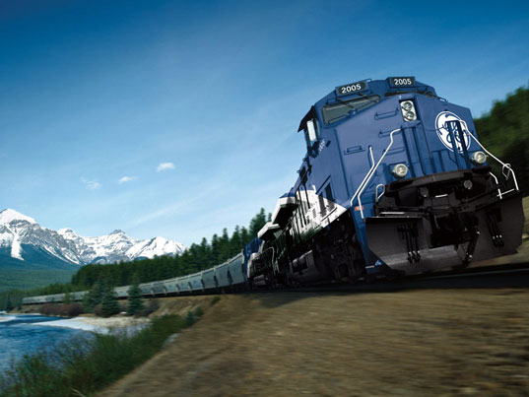
Railroad Block Signal
Railroad Block Signal Software Tool
Team Members:
Kenneth Truex
Chad Mason
Zachary McHenry
Christopher Diebold

Slide 2
Previous Goals
Task | Completion % | Kenneth Truex | Christopher Diebold | Chad Mason | Zachary McHenry | To Do
Create the user forms | 70% |  |  | 70% |  | Implement GE’s UI Template
Finish the algorithms | 100% | 100%
Query the database | 100% |  | 100%
Look into multithreading | 85% |  |  | 30% |  | Implement Semaphore
Implement Excel Parser | 100% |  |  |  | 100%

Slide 3
Milestone 3 Accomplishment Summary

Slide 4
Create the User Forms
Take UI design and alter it to resemble the UI design template provided to us by GE.
Upon initial review, our demo design was a very close match to what GE had in its examples.
We are 70% done with the alterations of the portions that were not a match.

Slide 5
Finish the Algorithms
Added assert statement to ensure the function will never return a negative value
Ensure that the function returns the correct value to the Track Layout class to be stored in the object

Slide 6
Query the Database

Slide 7
Look into Multithreading

Slide 8
Implement Excel Parser

Slide 9
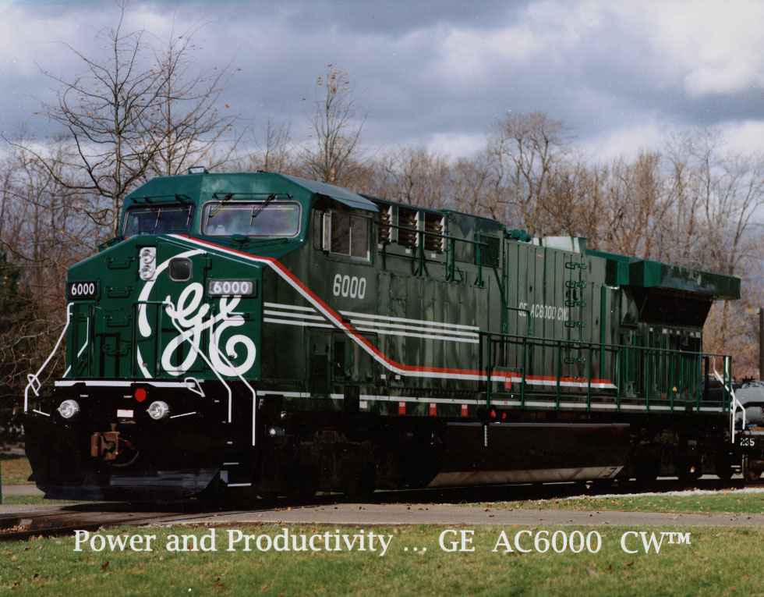
Next Milestone

Slide 10
Milestone 4

Slide 11
Milestone 4 Role Distribution
Task | Kenneth Truex | Christopher Diebold | Chad Mason | Zachary McHenry

Slide 12
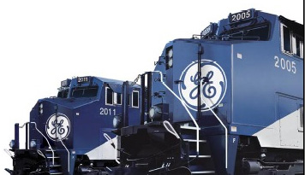
Any Questions?

